Slide 1
Let’s talk about Coversational Interfaces
Philip Wheat

Slide 2
Format of Talk
Concepts
What
Why
Who
When
How
Questions
Implementations
Platforms
Infrastructure
Code
Questions and Wrapup

Slide 3
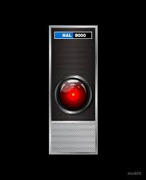

Slide 4


Slide 5

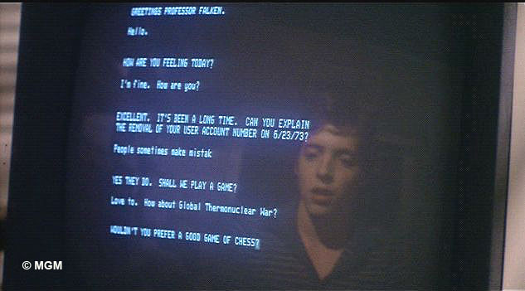

Slide 6
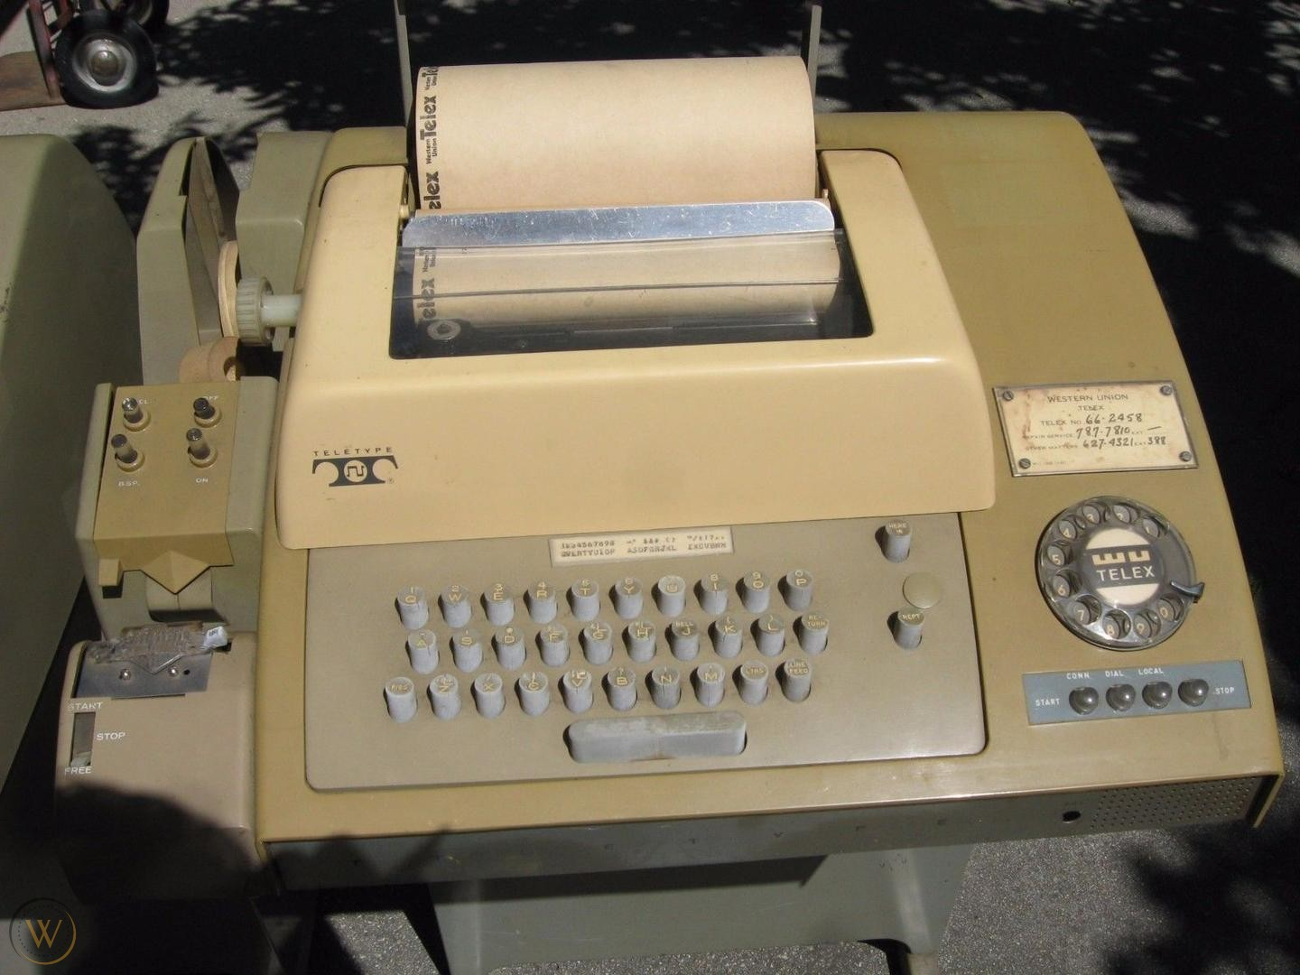

Slide 7
What are we talking about?
Interfaces that provide two way interaction.
Goes beyond simple voice commands
Command – action is not a conversation, but can be a component of it.
We’ll be primarily talking about a 2 party conversation here.
3+ party conversations are an interesting problem as well.
Usually is human initiated, but shouldn’t need to be.
Does not have to be voice or text only.
Often goes by the term “Chatbot”

Slide 8
Why are we interested in this form?
Devices are becoming ever-present.
Visual interfaces are distracting.
Screens are either small and limited, or are vulnerable and distracting.
Can be more focused on objectives (which can be good or bad, depending on who you are.)
Can guide users who are not exactly sure what they need/want.

Slide 9
Who is the target audience?
Everyone!
Conversation is natural for the majority of people.
Auto-translation services are getting better.
Ability to “adjust” the interface means it can be highly personalized.
Companies that want to provide a better user experience than a traditional “Press 1 to…” or “Search the FAQ” one.

Slide 10
When will they be likely to use this?
When attention is needed for other tasks.
Transportation.
Hands on work.
Brainstorming/Ideation
Less likely in social situations for the near term.

Slide 11
How do we provide this type of interface?
Smart Speakers are leading the way.
Mobile devices.
Smart Environments are the end goal.

Slide 12
Questions?

Slide 13
What Platforms are available?
Google Assistant/Home
Amazon Alexa
Microsoft Cortana
Apple Siri
Custom solutions
(One example) - https://www.sparkfun.com/products/15453

Slide 14
Infrastructure – what else do you need?
While you can do some things using just the base services of the main providers, you’re likely going to want to use additional resources for the best offering.
Azure Functions
AWS Lambdas
Google Cloud Functions.

Slide 15
Some code to get you started
https://github.com/mitchellgordon95/DungeonForGoogleHome
https://github.com/SciSharp/BotSharp
https://github.com/PhilWheat/HoustonTechFestAssistantExample

